Slide 1

Introduction
Overview. the Internet, protocols
Network edge
Network core: packet/circuit switching
Performance: loss, delay, throughput
Protocol layers, service models
Security
History
Supplemental: who uses the Internet?
Computer Networking: A Top-Down Approach
8th edition
Jim Kurose, Keith Ross
Pearson, 2020
Notes:
Version History
January 2022

Slide 2
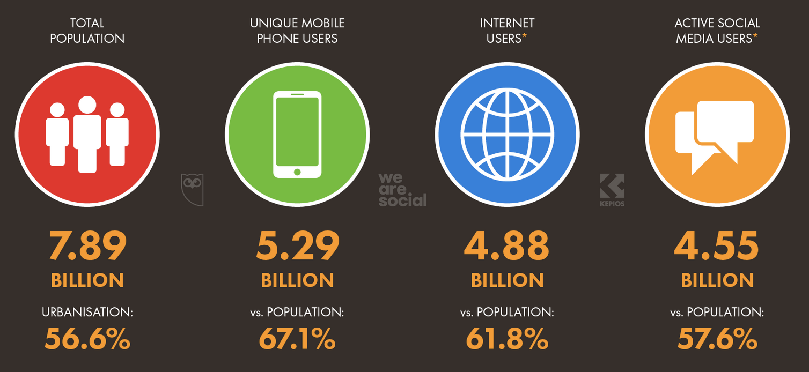
“Who uses the Internet?”
2021 snapshot: global Internet/mobile connectivity:
Oct. 2021, Source: http://datareportal.com/reports/a-decade-in-digital

Slide 3
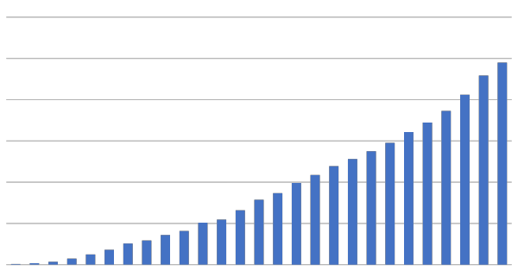
Number of global Internet users (over time)
4.90
4.58
4B
3B
1.98
2B
1.98
1.02
Primary reasons why global Internet users aged 16 to 64 use the Internet
1B
0.36
0.016
1995
2000
2005
2010
2015
2021
Sources: https://www.itu.int/en/ITU-D/Statistics/Pages/stat/

Slide 4
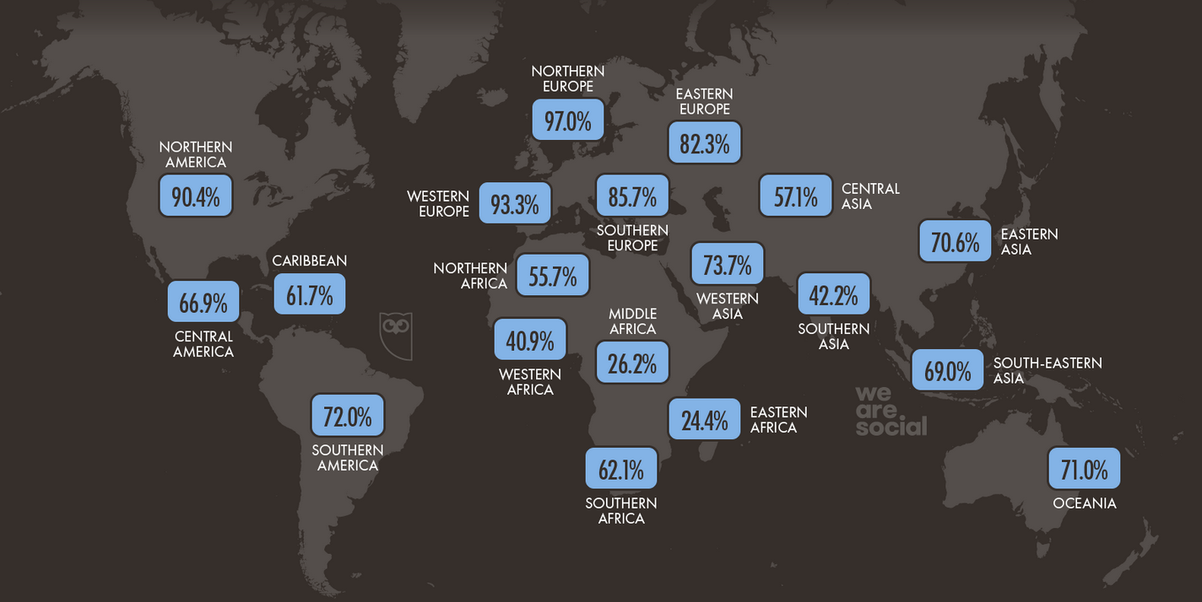
Internet/mobile adoption, by region
Internet adoption as a percentage of region’s population
April 2021, Source: https://datareportal.com/reports/6-in-10-people-around-the-world-now-use-the-internet

Slide 5
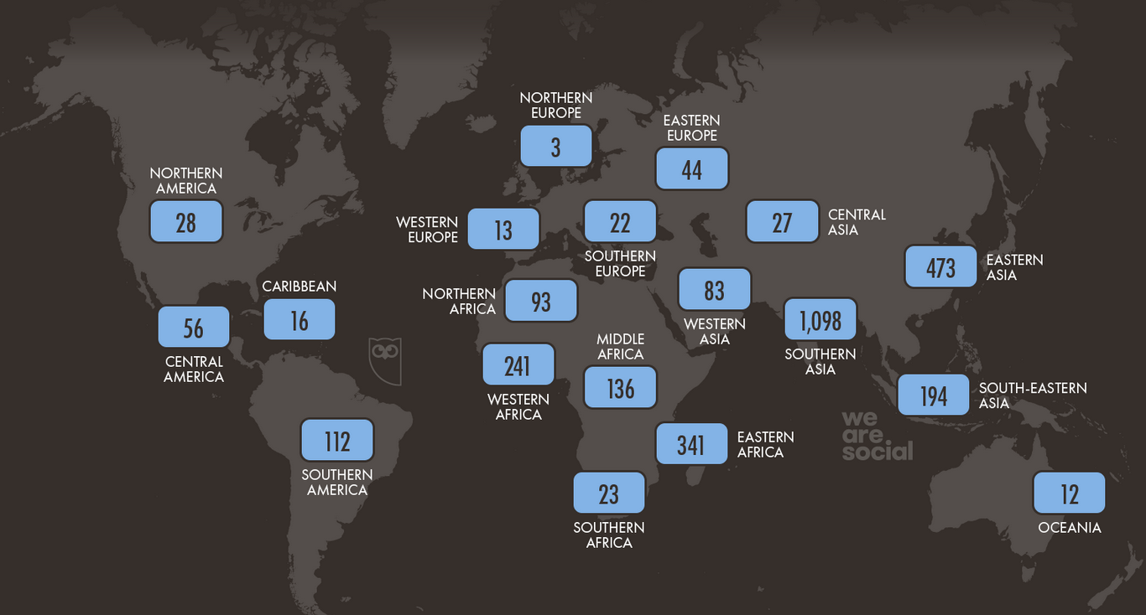
Internet/mobile adoption: the missing 3B
Number of people (in M) in region without Internet access
Nov. 2021, Source: http://datareportal.com/reports/a-decade-in-digital

Slide 6
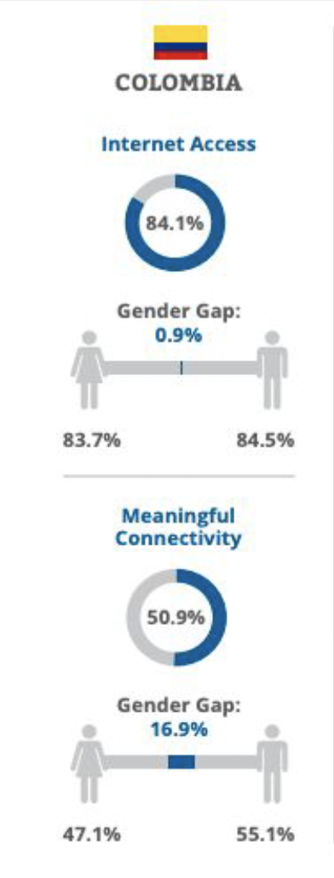
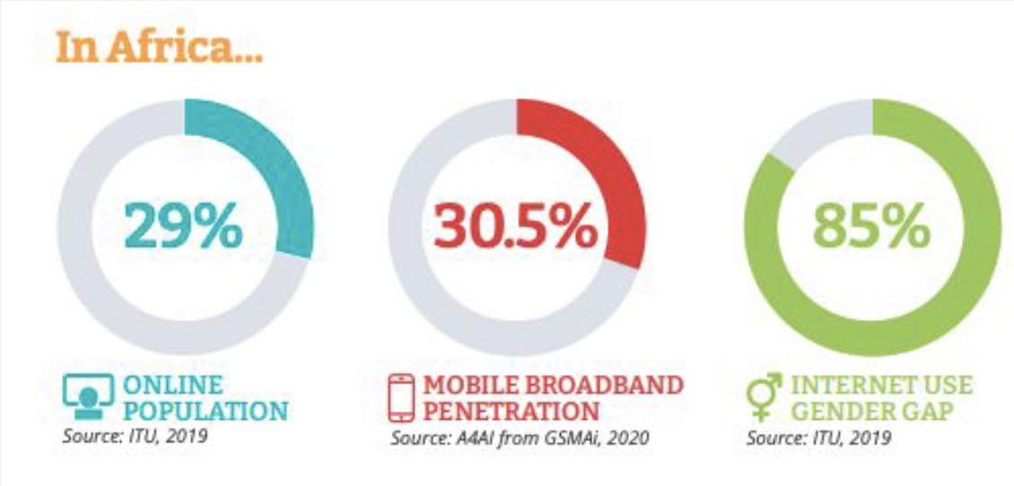
Beyond “Connectivity”
Meaningful Connectivity: the ability to use the internet every day using an appropriate device with enough data and a fast connection.
Looking beyond “connectivity” to meaningful connectivity, affordability, gender disparities, and more...
43 out of 95 countries met “1 for 2” affordability target:
1GB for 2% or less of average monthly income.
Source: A4ai.org

Slide 7
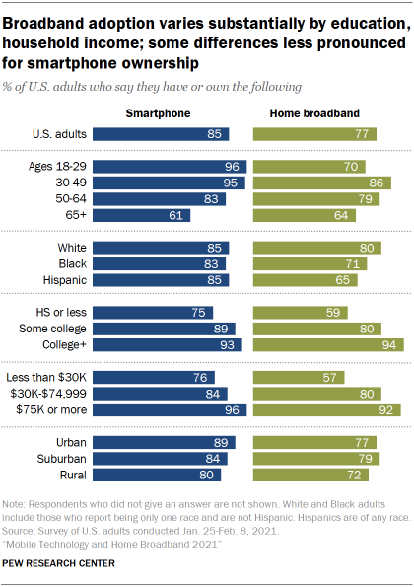
US broadband, smartphone ownership variation and inequities: 2021 snapshot
Age, race, education level, income, urban/rural differences
Broadband differences greater than smartphone
Feb. 2021, source: https://www.pewresearch.org/internet/2021/06/03/mobile-technology-and-home-broadband-2021/
Notes:
https://www.pewresearch.org/internet/2021/06/03/mobile-technology-and-home-broadband-2021/

Slide 8
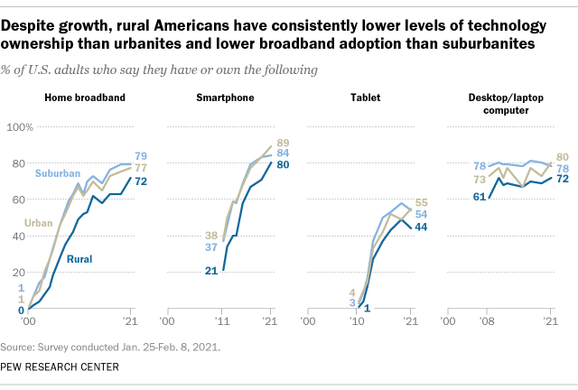
Changing US rural/urban “digital divide”
Feb. 2021, Source: https://www.pewresearch.org/fact-tank/2021/08/19/some-digital-divides-persist-between-rural-urban-and-suburban-america/
Notes:
https://www.census.gov/programs-surveys/geography/guidance/geo-areas/urban-rural.html defines rural/urban
Graph is from: https://www.pewresearch.org/fact-tank/2021/08/19/some-digital-divides-persist-between-rural-urban-and-suburban-america/

Slide 9
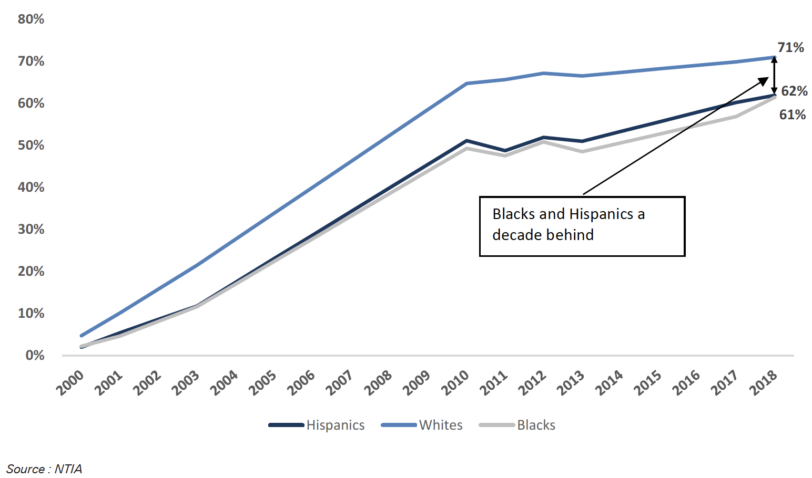
Changing US racial “digital divide” over time
Notes:
Graph is from:
https://www.dbresearch.com/PROD/RPS_DE-PROD/PROD0000000000511664/America%27s_Racial_Gap_%26_Big_Tech%27s_Closing_Window.PDF

Slide 10
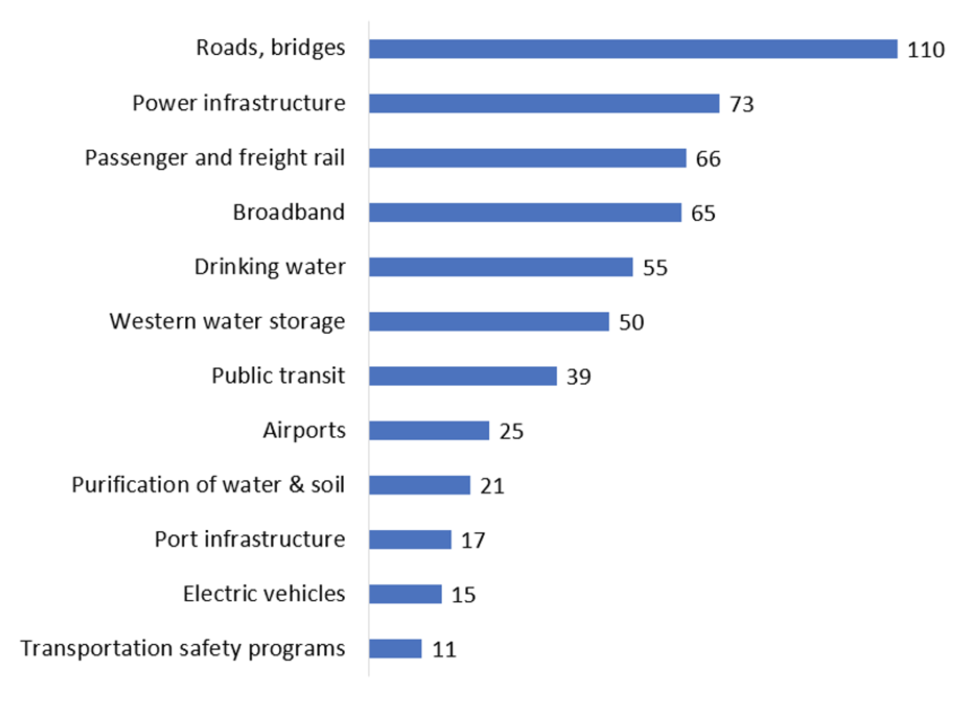
2021 US Infrastructure Investment and Jobs Act
Broadband Equity, Access, and Deployment. $42.5B in grants to states to expand broadband deployment in underserved areas
Affordable Connectivity Fund. $14.2B. Up to $30/month reimbursement per household for broadband access cost
Digital Equity. $2.75B to ensure “individuals and communities have the IT capacity that is needed for full participations in the society and economy of the US.”
Tribal Broadband Connectivity Program. $2B
Rural Utilities ServiceReConnect. $2B
$65B investment in broadband (of $550B in total infrastructure investments, over 10 years)
Notes:
Source: https://www.aei.org/research-products/report/broadband-provisions-in-the-infrastructure-investment-and-jobs-act-a-primer/

Slide 11
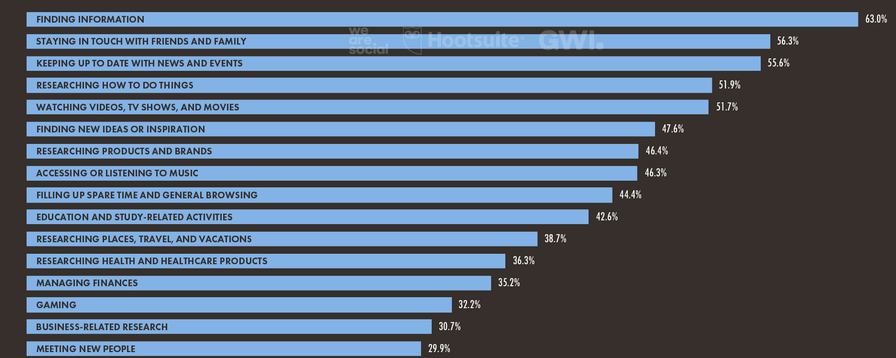
Using the Internet
Primary reasons why global Internet users aged 16 to 64 use the Internet
Jan. 2021, Source: https://datareportal.com/reports/digital-2021-global-overview-report

Slide 12
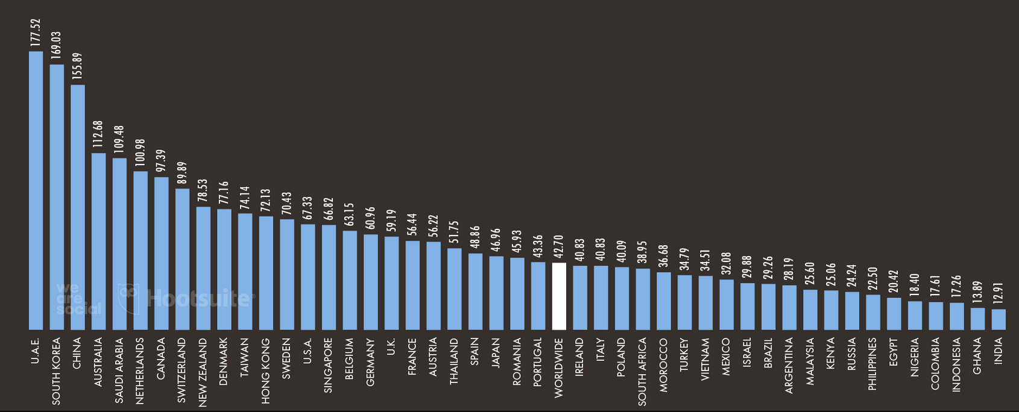
Average mobile download access rates
UAE: 177.5 Mbps
Average mobile Internet download speed (in Mbps), by country
US: 67.3 Mbps
Jan. 2021, Source: https://datareportal.com/reports/digital-2021-global-overview-report

Slide 13
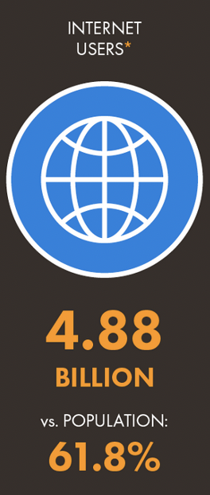
“Who uses the Internet?”
Questions to consider:
Go to https://www.speedtest.net/ to measure your Internet access download speed. Try it from different places/devices if you can.
If somebody were to turn off the internet, what would you miss most?
How does Internet use change around the world?
How much choice do you/your family have for home connectivity, among ISPs? How does the amount of choice vary by country?

Slide 14
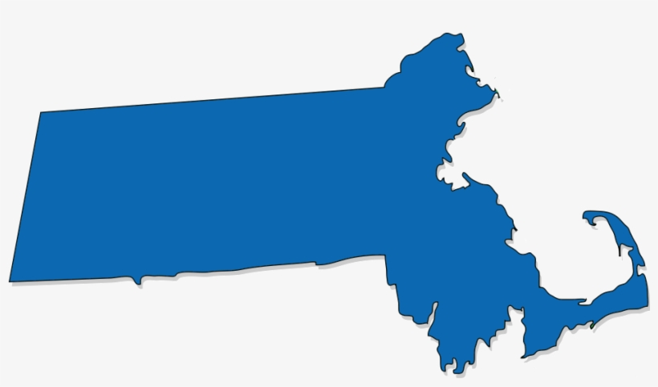







Comcast network
cable headend
…
home network
Speedtest from house (via home cable access net) to Boston Comcast server

Slide 15


Comcast network
Verizon wireless
network
alter.net
Speedtest from Verizon mobile phone in western MA to Boston Comcast server

Slide 16
Who “controls” the Internet?
a great question, but ...
INTERNET USERS
INTERNET SERVICE PROVIDERS
IT’S COMPLICATED
IT’S REALLY COMPLICATED
NATION STATES (COUNTRIES)
UNITED NATIONS
STANDARDS BODIES (e.g., IETF)
INTERNET EQUIPMENT MANUFACTURES
SKYNET INC.
NON-PROFIT ORGANIZATION(S)

Slide 17

“Who controls the Internet?”
a great question, but ...
INTERNET USERS
analogies to other infrastructure: roads, railroads, water systems
  regional, state, national, international governance
  standards
  role of industry, user groups, non-profits
a great question, but ...
INTERNET SERVICE PROVIDERS
IT’S COMPLICATED
IT’S REALLY COMPLICATED
NATION STATES (COUNTRIES)
UNITED NATIONS
STANDARDS BODIES (e.g., IETF)
INTERNET EQUIPMENT MANUFACTURES
SKYNET INC.
NON-PROFIT ORGANIZATION(S)

Slide 18
“Who controls the Internet?”
a great question, but ...
INTERNET USERS
analogies to other infrastructure: roads, railroads, water systems
  regional, state, national, international governance
  standards
  role of industry, user groups, non-profits
a great question, but ...
INTERNET SERVICE PROVIDERS
IT’S COMPLICATED
IT’S REALLY COMPLICATED
NATION STATES (COUNTRIES)
UNITED NATIONS
STANDARDS BODIES (e.g., IETF)
who are the “actors”, who cares, and who makes decisions?
  multistakeholder governance model
  “tussle”/conflicts among actors “who care”
INTERNET EQUIPMENT MANUFACTURES
SKYNET INC.
NON-PROFIT ORGANIZATION(S)

Slide 19
Who “controls” the Internet: breaking the problem down
Reference model for discussing governance (different from Internet/OSI protocol stack):
V. Cerf, P. Ryan, M. Senges, “Internet Governance Is Our Shared Responsibility”
I/S: A Journal of Law and Policy for the Information Society, 10 ISJLP 1 (2014).

Slide 20
Who “controls” the Internet: breaking the problem down
Reference model for discussing governance (different from Internet/OSI protocol stack):
content layer
names, numbers
infrastructure layer

Slide 21
Who “controls” the Internet: breaking the problem down
Reference model for discussing governance (different from Internet/OSI protocol stack):
social
Policy and social processes
intellectual property
content definition, filtering, regulation
content layer
Technical standards, and social processes for
Internet names (e.g., www.umass.edu)
Internet addresses (e.g., 128.119.40.186)
names, numbers
Technical standards for
hardware: links, switches, routers
protocols, message formats
data formats (e.g., mp4)
infrastructure layer
technical

Slide 22
Who “controls” the Internet: some of the players
Reference model (different than Internet/OSI protocol stack) for discussing issues:
social
content layer
Internet Governance Forum (IGF)
companies,
organizations (platforms, content producers )
national
governments
Internet Corp. for Assigned Names and Numbers (ICANN)
International Telecomm. Union (ITU)
names, numbers
Internet Engineering Task Force (IETF)
World Wide Web Consortium (W3C)
3GPP
3rd Generation Partnership Project
Inst. For Electrical and Electronics Engineers (IEEE)
infrastructure layer
technical

Slide 23
Who “controls” the Internet: some of the players
Reference model (different than Internet/OSI protocol stack) for discussing issues:
social
content layer
Internet Governance Forum (IGF)
companies (e.g., Google, facebook)
national
governments
Internet Corp. for Assigned Names and Numbers (ICANN)
International Telecomm. Union (ITU)
logical layer
Internet Engineering Task Force (IETF)
3GPP
3rd Generation Partnership Project
Inst. For Electrical and Electronics Engineers (IEEE)
infrastructure layer
technical

Slide 24
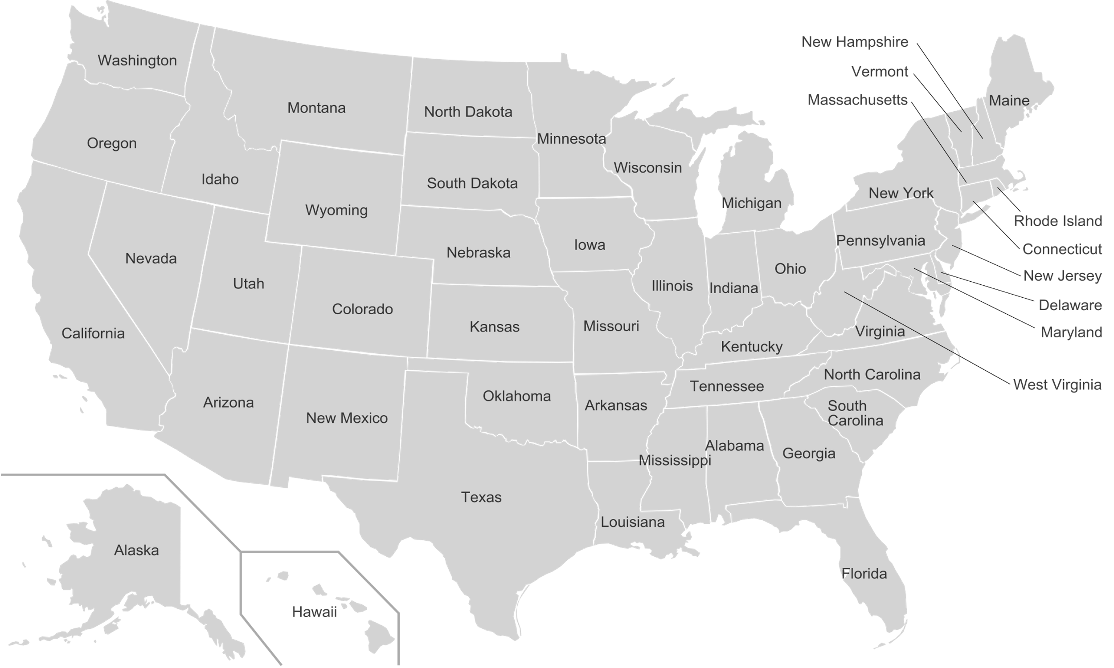
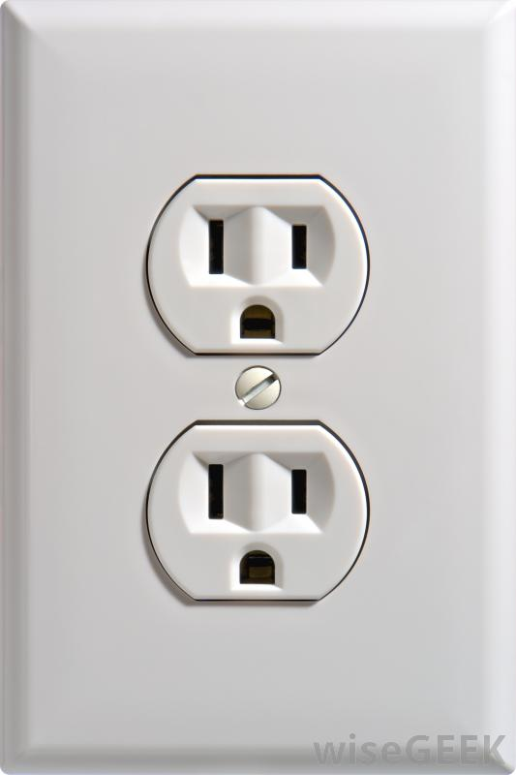
Technical Standards: why standards?
110V, standard US electrical socket
Notes:
Quote from
Anthony Ralston and Edwin C. Reilly, ed. Encyclopedia of Computer Science, Third Edition (New York: Van Nostrand Reinhold USA, 1993) s.v. “Standards”
As quoted in
Why Standardization Efforts Fail
Carl F. Cargill
Volume 14, Issue 1: Standards, Summer 2011
DOI: https://doi.org/10.3998/3336451.0014.103
Permissions

Slide 25
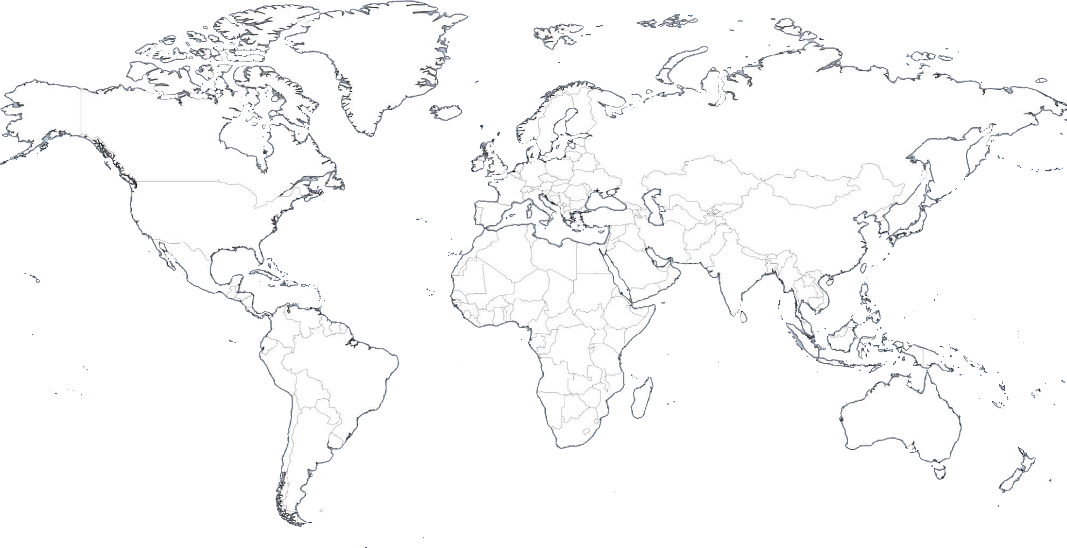
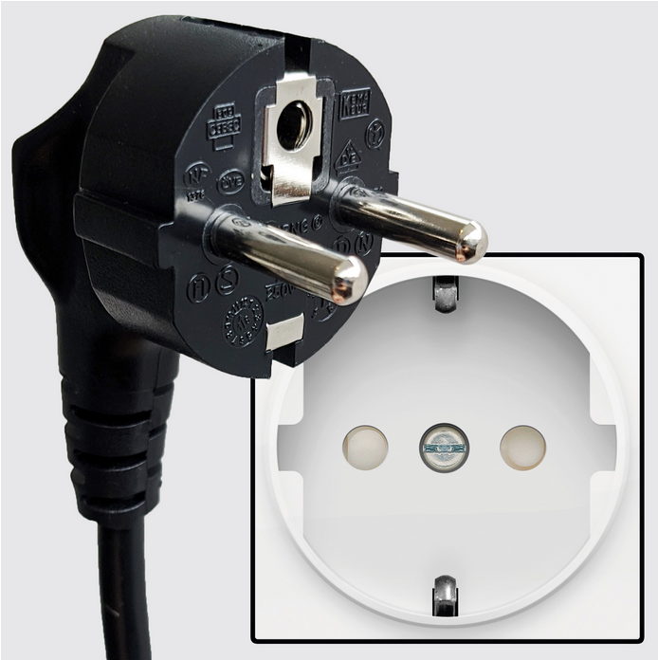
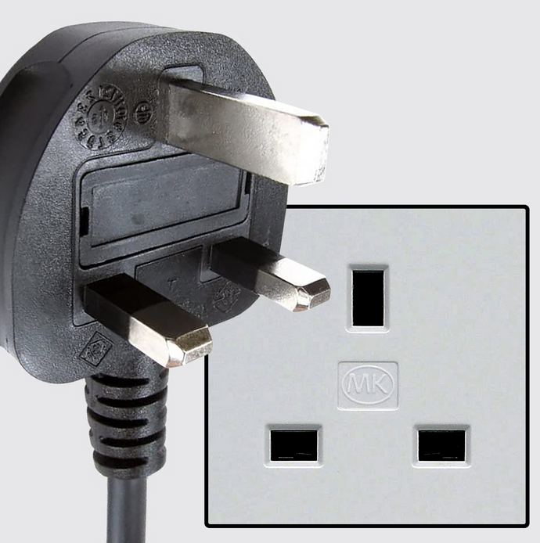
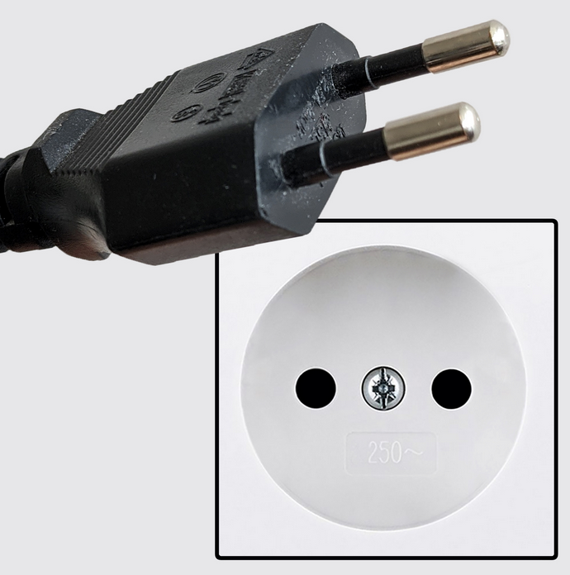
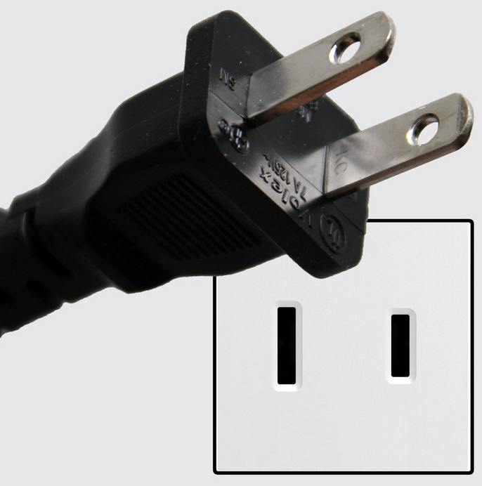
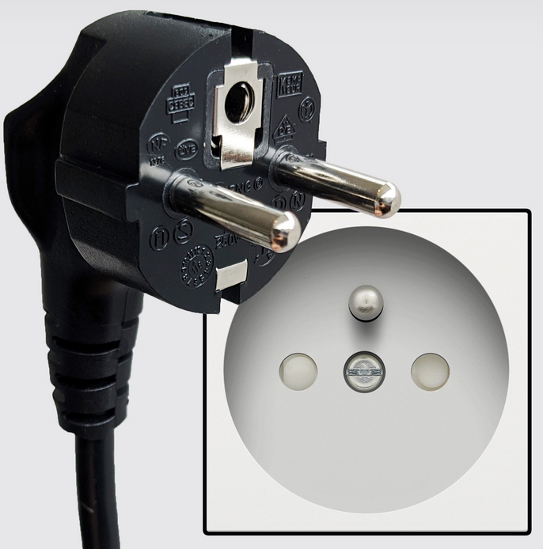
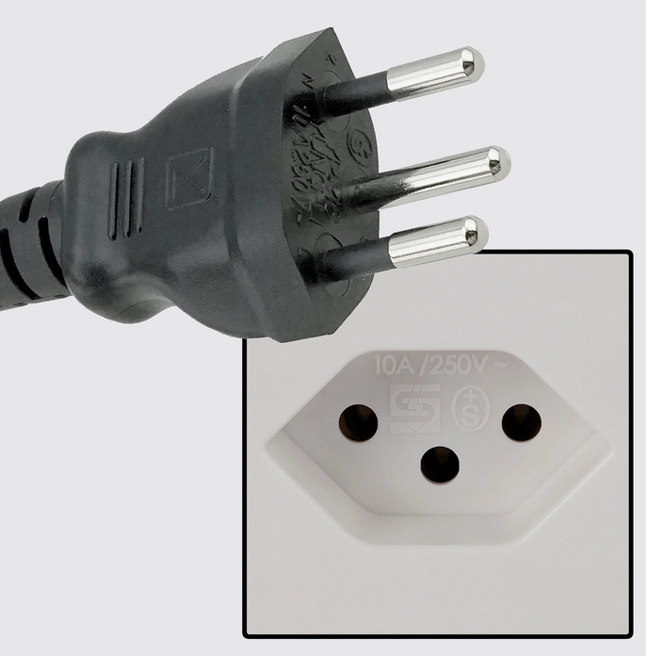
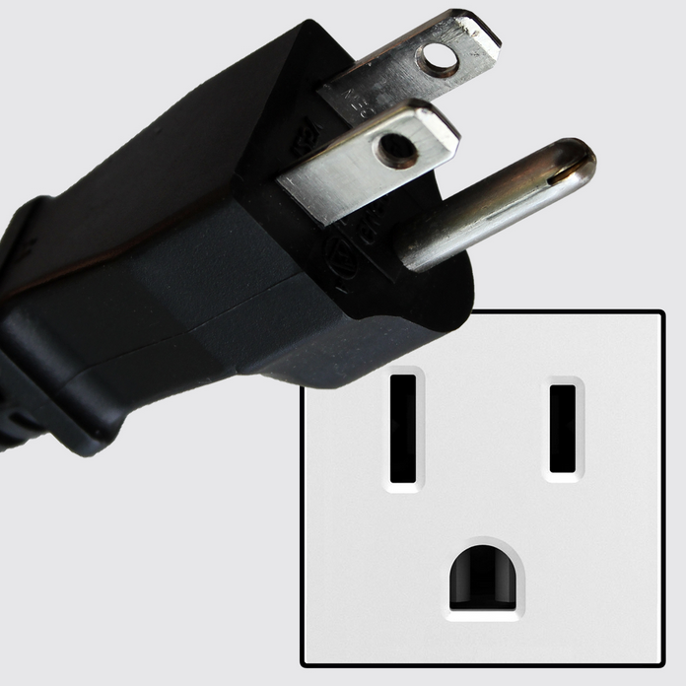
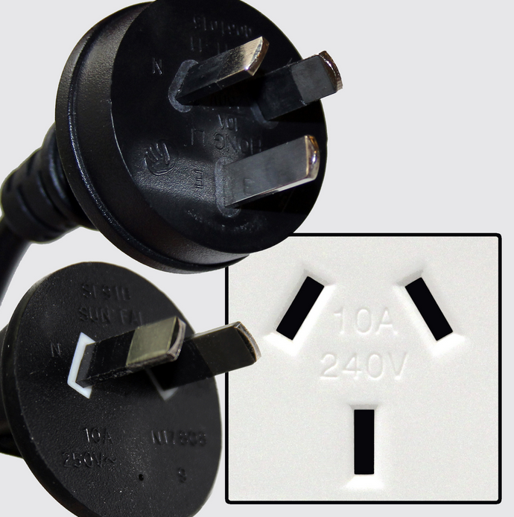
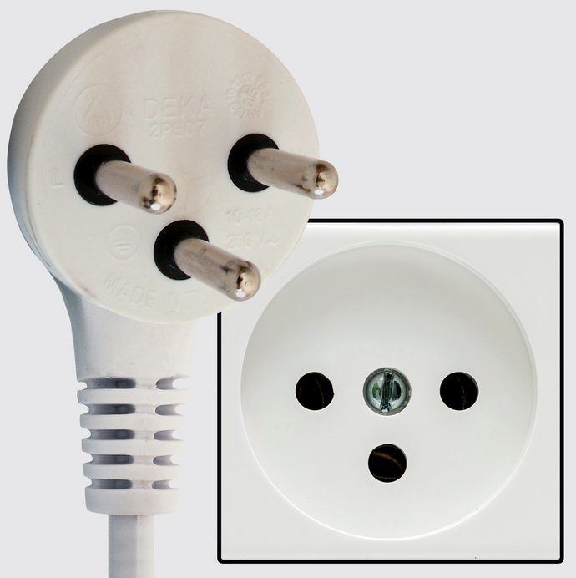
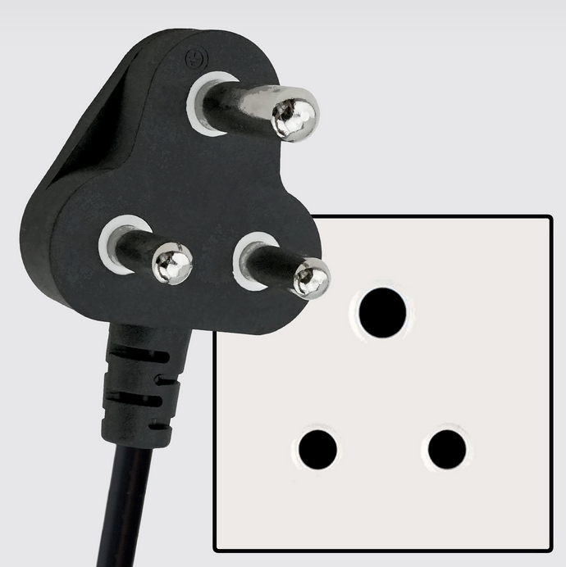
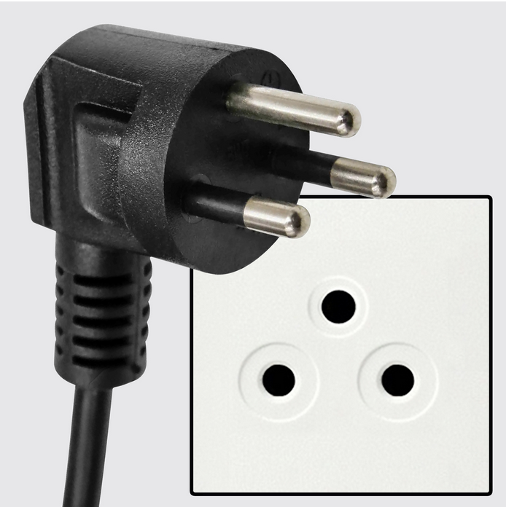
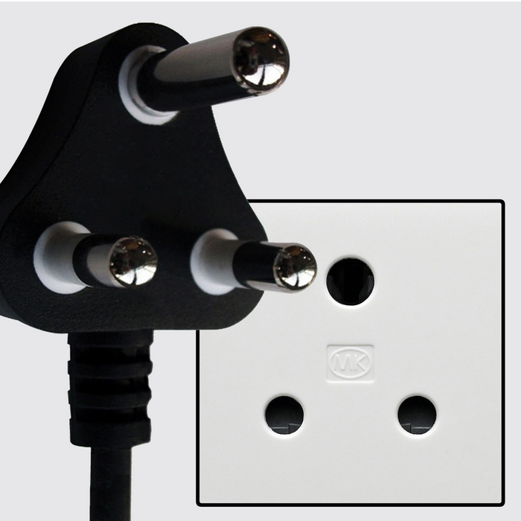
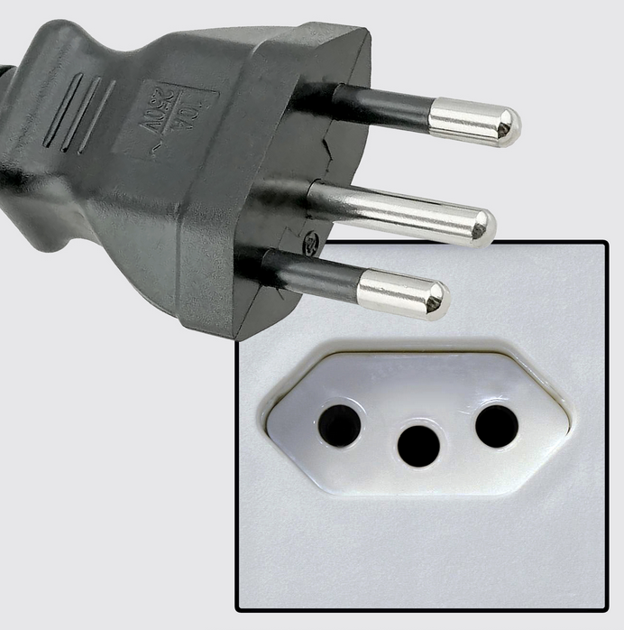
Technical Standards: why standards?
110V, standard US electrical socket
15 plug standards worldwide; 110V and 220V standards
Standards are needed for interoperability and interconnectability
“…(s)tandards are one of the hallmarks of an industrial society. As the society becomes increasingly complex and its industrial base begins to emerge, it becomes necessary for the products, processes, and procedures of the society to fit together and to interoperate. This interoperation provides the basis for greater integration of the elements of society, which in turn causes increased social interdependency and complexity.”
Notes:
Quote from
Anthony Ralston and Edwin C. Reilly, ed. Encyclopedia of Computer Science, Third Edition (New York: Van Nostrand Reinhold USA, 1993) s.v. “Standards”
As quoted in
Why Standardization Efforts Fail
Carl F. Cargill
Volume 14, Issue 1: Standards, Summer 2011
DOI: https://doi.org/10.3998/3336451.0014.103
Permissions

Slide 26
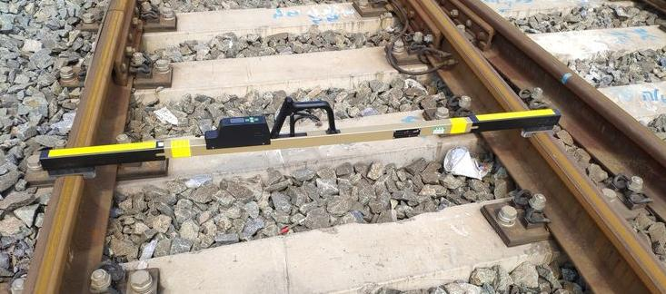
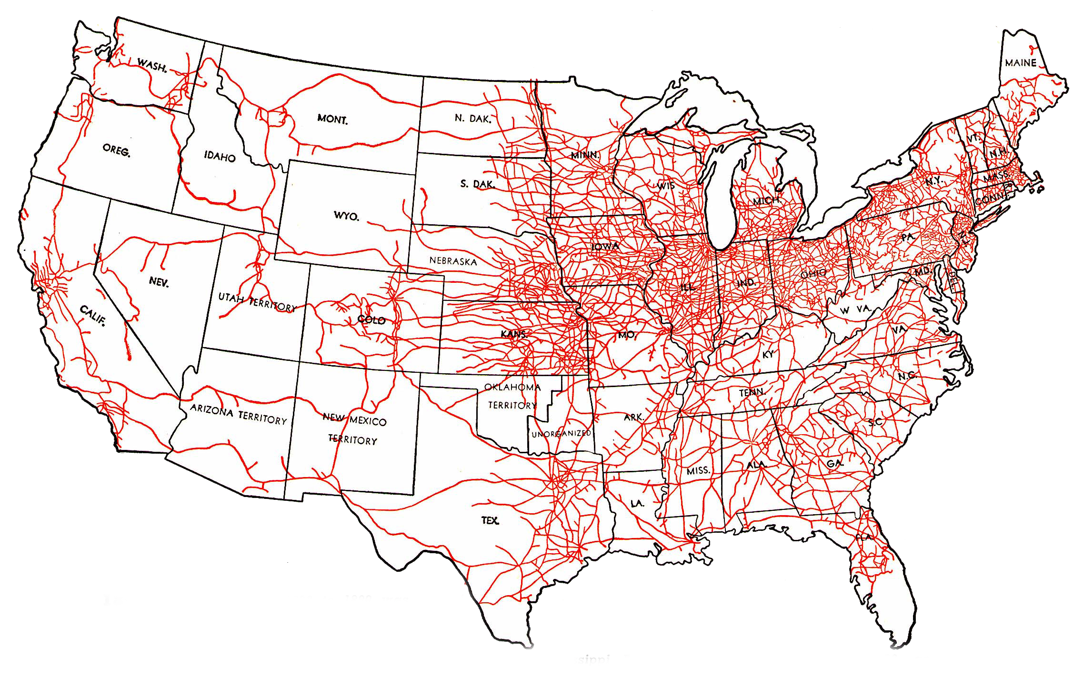
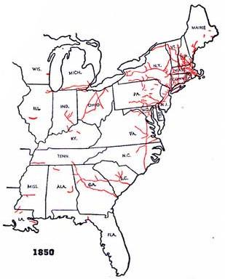
Technical Standards: why standards?
railroad track gauge
4’ 8.5”
5’6” (Canada)
4’8.5”
6’0”
4’9”
1886: a single 4’ 8.5” national track gauge standard
5’0”
Fun with railroad standards:
1862: US gov’t convenes major railroad owners, standards discussed
1867: 29 railroad companies form Master Car Builders Association
1886: 4’ 8.5” standard gauge adopted
Ties between 4’ 8.5” gauge, and ancient roman roads (e.g., Pompei)
1860: 20 different track gauges

Slide 27

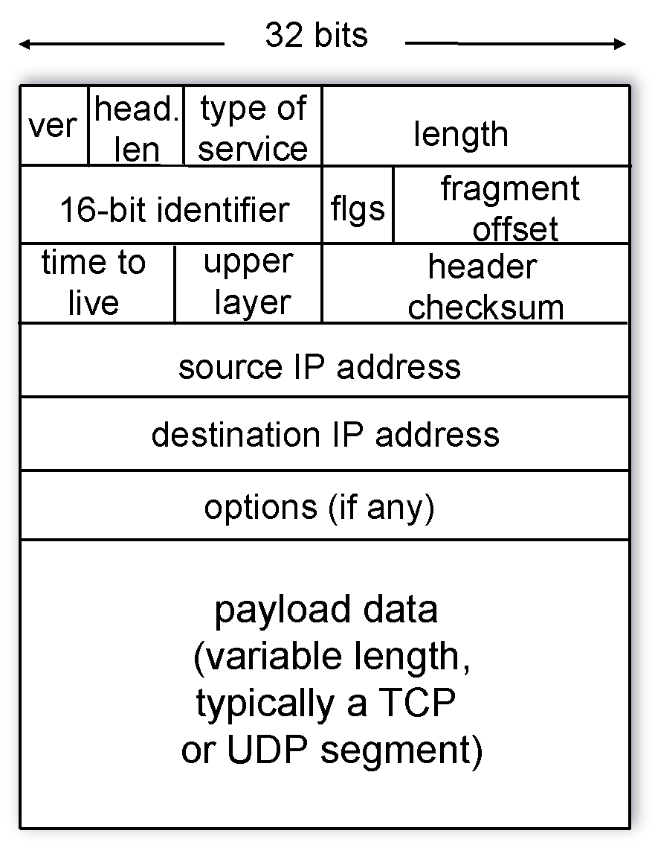
Internet Engineering Task Force (IETF, www.ietf.org)
multiple stakeholders: “ ... a large open international community of network designers, operators, vendors, and researchers concerned with the evolution of the Internet architecture and the smooth operation of the Internet.”
process: working groups, twice a year open IETF meetings
  “rough consensus and running code”
Requests for Comments (RFCs)
  “technical standards” defining Internet protocols (e.g., IP, TCP, UDP, HTTP)
  > 9000 RFCs to date
IP datagram format (RFC 791)

Slide 28

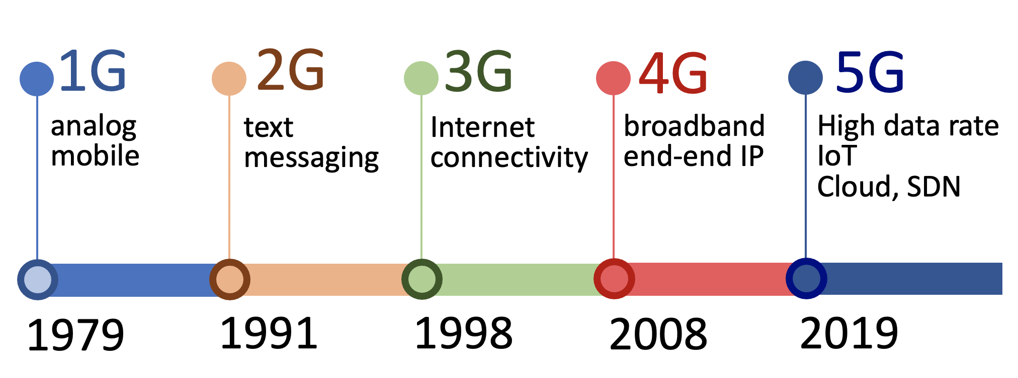
3rd Generation Partnership Project (3GPP, www.3gpp.org)
alliance of 7 global telecommunications standards groups
  745 member companies
16 working groups, in three technical areas:
  radio access network
  service/systems aspects
  core network, terminals
technical specifications:3G, 4G (LTE), 5G
cellular networks
18 “releases” (like OS “release”), over three “generations”: 3G, 4G, 5G
Notes:
https://www.qualcomm.com/news/onq/2017/08/02/understanding-3gpp-starting-basics
https://webapp.etsi.org/3gppmembership/QueryForm.asp

Slide 29
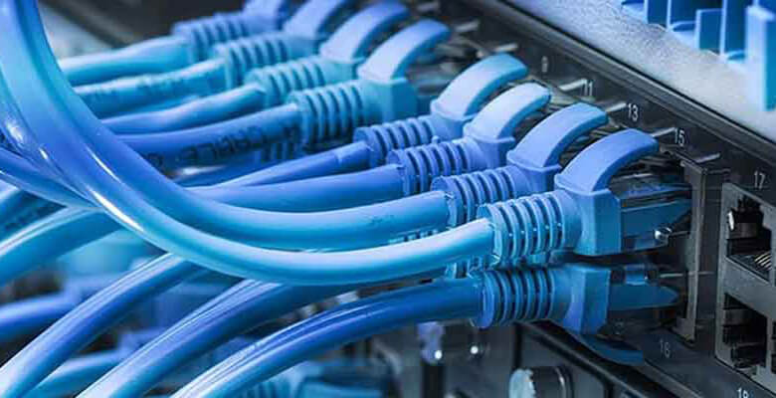

IEEE standards
Int. Telecommunication Union (ITU)
IEEE: professional organization for electrical engineers
  standards subgroup manages standards process, industry typically participates
wired Ethernet standard (802.3)
wireless WiFi standard (802.11)
formed 1865 (not a typo!)
telegraph, landline phone network standards
United Nations agency since 1949
193 member countries, !900 companies
not in the lead for Internet, mobile cellular networking
Notes:
https://www.qualcomm.com/news/onq/2017/08/02/understanding-3gpp-starting-basics
https://webapp.etsi.org/3gppmembership/QueryForm.asp

Slide 30
Who “controls” the Internet: some of the players
social
content layer
Internet Governance Forum (IGF)
companies,
organizations (platforms, content producers )
national
governments
Internet Corp. for Assigned Names and Numbers (ICANN)
International Telecomm. Union (ITU)
names, numbers
Internet Engineering Task Force (IETF)
World Wide Web Consortium (W3C)
3GPP
3rd Generation Partnership Project
Inst. For Electrical and Electronics Engineers (IEEE)
infrastructure layer
technical

Slide 31
ICANN: Internet Corporation for Assigned Names and Numbers
non-profit, multistakeholder organization
handles (assigns, adjudicates) Internet names
  e.g., www.umass.edu “belongs to” UMass Amherst campus
  e.g., www.apple.com “belongs” to the Apple Corporation
  What about .PATAGONIA? (region in South America, or outdoorsy company?)
  What if someone creates JimKuroseIsAFlamingIdiot.com?
Names are important!
“A person's name is to that person, the sweetest, most important sound in any language.” (Dale Carnegie)
voice.com domain name sold for $30M in 2019
assigns Internet addresses to names, and manages translation between name and address (Domain Name System, more shortly)
  e.g., www.cics.umass.edu has IP address 128.119.240.84
Notes:
https://www.qualcomm.com/news/onq/2017/08/02/understanding-3gpp-starting-basics
https://webapp.etsi.org/3gppmembership/QueryForm.asp

Slide 32
ICANN: Internet Corporation for Assigned Names and Numbers
non-profit, founded 1998 to internationalize Internet naming/addressing, previously overseen by U.S. gov’t
bottom-up, consensus-based multistakeholder processes
  open meetings, anyone can address ICANN Board (e.g., in contrast to UN model)
  governments have an equal voice with others, e.g., businesses, academics, and civil society (e.g., on advisory committees)
  Board ... advised by four committees makes final decisions, following multiple public postings, reviews, discussion.
increased pressure by some for more explicit government control
  2012 proposal (Russia, UAE, China, Saudi Arabia, Algeria, Sudan, Egypt in WCIT) required:
“Member States [countries] shall have equal rights to manage the Internet, including ....”
argues for government supremacy in Internet control; no mention of other voices
Notes:
https://www.qualcomm.com/news/onq/2017/08/02/understanding-3gpp-starting-basics
https://webapp.etsi.org/3gppmembership/QueryForm.asp

Slide 33
Who “controls” the Internet: some of the players
social
content layer
Internet Governance Forum (IGF)
companies,
organizations (platforms, content producers )
national
governments
Internet Corp. for Assigned Names and Numbers (ICANN)
International Telecomm. Union (ITU)
names, numbers
Internet Engineering Task Force (IETF)
World Wide Web Consortium (W3C)
3GPP
3rd Generation Partnership Project
Inst. For Electrical and Electronics Engineers (IEEE)
infrastructure layer
technical

Slide 34

IGF: Internet Governance Forum
convened by UN secretary-general in 2006, renewed in 2015 for “multistakeholder policy dialogue”
does not make decisions, but rather a deliberation body that “informs and inspires those who do”
“Ultimately the involvement of all stakeholders, from developed as well as developing countries, from governments to international organisations, from the private sector to the civil society, is necessary for advancing dynamic public policies in Internet governance.” [https://www.intgovforum.org]
Notes:
https://www.qualcomm.com/news/onq/2017/08/02/understanding-3gpp-starting-basics
https://webapp.etsi.org/3gppmembership/QueryForm.asp

Slide 35






Controlling the content layer: content providers
Millions of websites, services control what you experience - in some ways no differently than traditional media.
“Section 230” (47 U.S.C. § 230), part of US Communications Decency Act, provides immunity for website platforms with respect to third-party content:
“No provider or user of an interactive computer service shall be treated as the publisher or speaker of any information provided by another information content provider.”
... more later
Notes:
https://www.qualcomm.com/news/onq/2017/08/02/understanding-3gpp-starting-basics
https://webapp.etsi.org/3gppmembership/QueryForm.asp

Slide 36

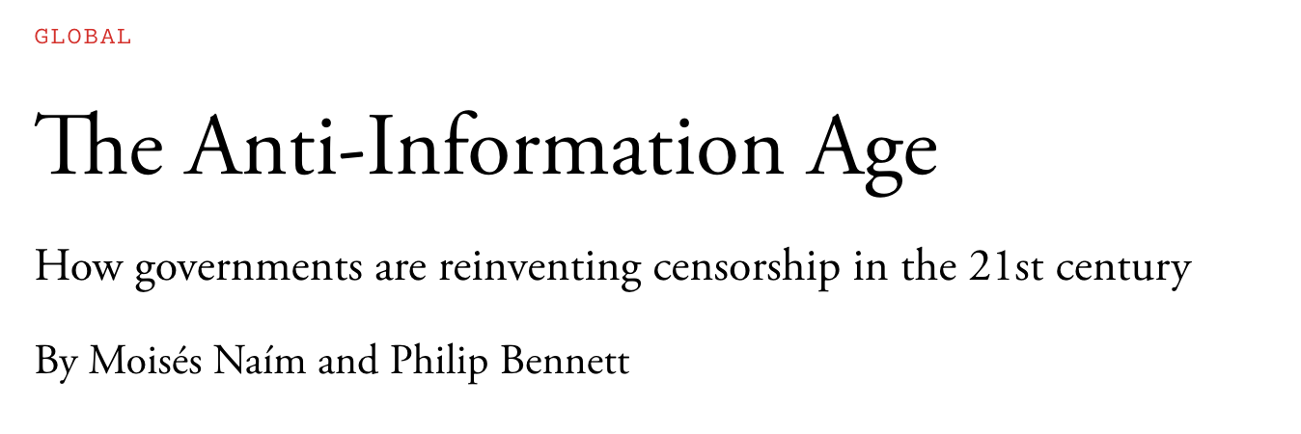

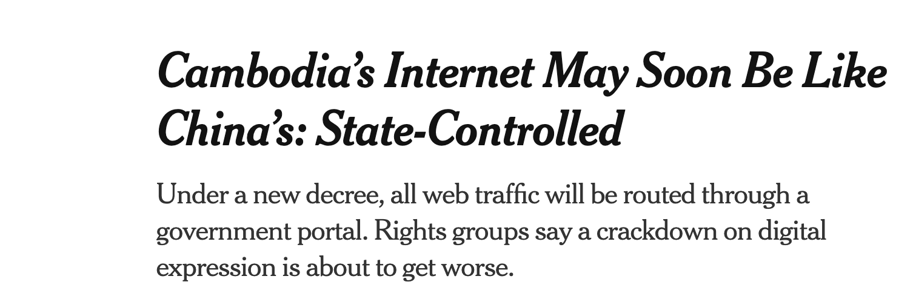
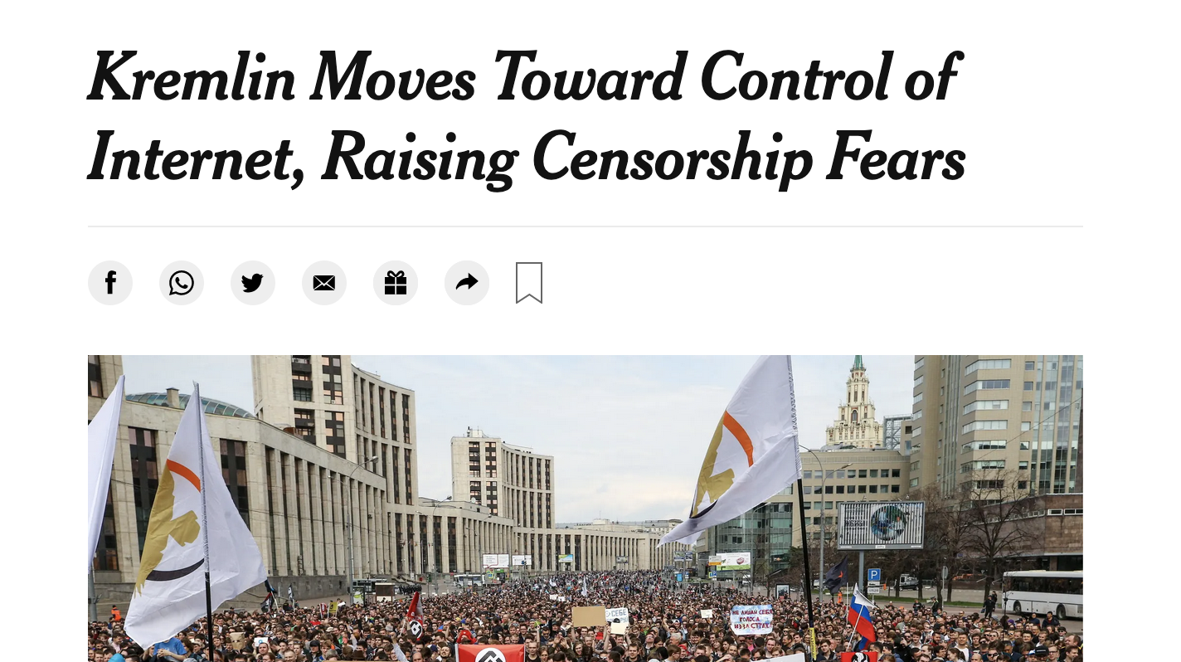

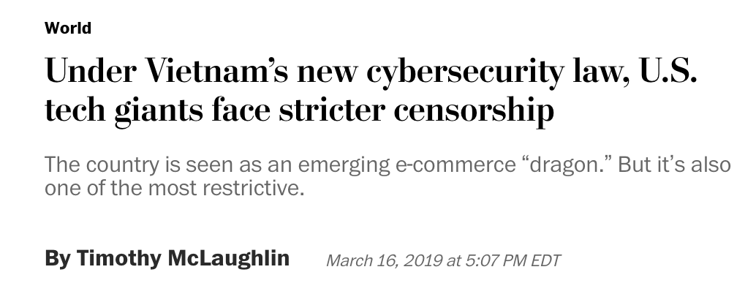
Controlling the content layer: governments
(Jan. 2022)
(Apr. 2019)
Notes:
https://www.qualcomm.com/news/onq/2017/08/02/understanding-3gpp-starting-basics
https://webapp.etsi.org/3gppmembership/QueryForm.asp

Slide 37





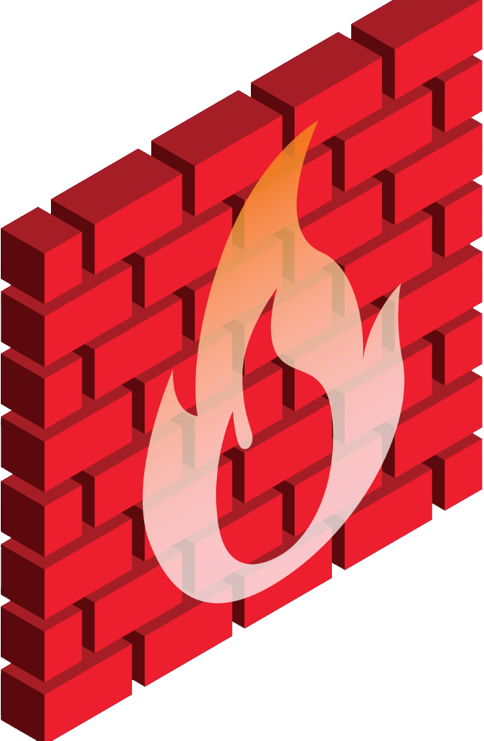





Controlling content flow: a network perspective
firewall: mechanism to control content access via programmable rules:
“don’t forward any packets to 128.118.40.186”
mobile network
local, regional or national ISP
“don’t forward any packets containing the phrase X anywhere”
... more later
“firewall”
replicated content at different IP address
home network
Internet
enterprise
network
content
provider
128.119.40.186 content
datacenter
network
national boundary
Notes:
https://www.qualcomm.com/news/onq/2017/08/02/understanding-3gpp-starting-basics
https://webapp.etsi.org/3gppmembership/QueryForm.asp

Slide 38
“Who does control the Internet?”
a great question, but ...
INTERNET USERS
INTERNET SERVICE PROVIDERS
IT’S COMPLICATED
Questions to consider:
Which governance roles are global, which are more local?
Which stakeholders are becoming more or less influential over time?
How is Internet governance different from railroad, or phone (landline) network governance?
How is Internet governance different from, or similar to, press/media control/governance?
IT’S REALLY COMPLICATED
NATION STATES (COUNTRIES)
UNITED NATIONS
STANDARDS BODIES (e.g., IETF)
INTERNET EQUIPMENT MANUFACTURES
SKYNET INC.
NON-PROFIT ORGANIZATION(S)

